Slide 1
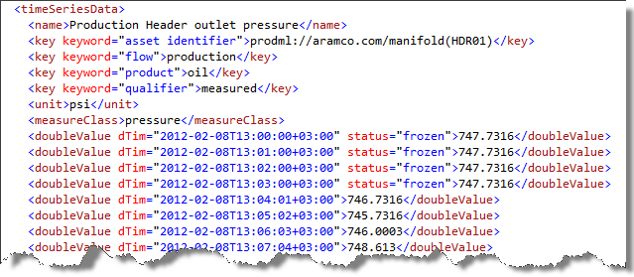
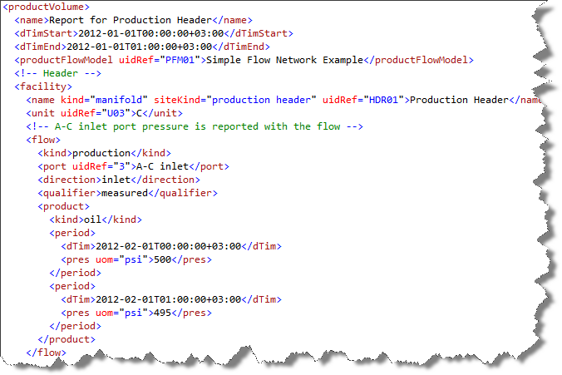
Static
Dynamic
1
2
3
A
B
C
1
3
5
Tag References
4
5
6
D
3
4
6
Time Series (Tag-Based Historian Data)
7
Facility References
7
8
E
oil
8
9
11
10
gas
9
10
water
Product Flow Model
Product Volume Report (Product Flow & Facility Parameter Data)

Slide 2
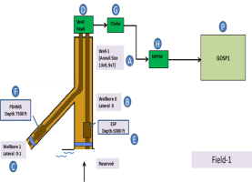
Allocation Model
Facilities Model
productFlowModel
Production Accounting System
Production Operations Monitoring System

Slide 3
Product Volume Report

Slide 4
